Slide 1

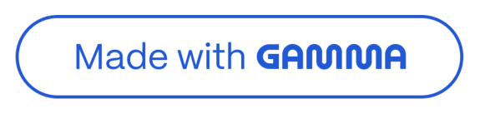

FarmConnect: Bridging Farmers to Markets
Transforming agricultural supply chains through digital innovation.
Submitted By:- Rutuja-28285
Guided By:- SR-UMESH SIR and Pushpa Ma'am
Rutuja-28285

Slide 2

Presentation Agenda
Introduction & Objectives
Understanding the challenge and our goals.
1
2
System Architecture
Key components and technology stack.
Core Functionality
Features for farmers and buyers.
3
4
Implementation & Testing
Detailed features and rigorous validation.
Conclusion & Future Scope
Summary and potential enhancements.
5
Rutuja-28285

Slide 3



Addressing the Market Disconnect
The Challenge
Traditional supply chain inefficiencies Limited farmer-market access
Lack of real-time data
Our Solution: FarmConnect
Digitizes agricultural supply chain Direct farmer-to-buyer interaction Real-time inventory management
Bridging the gap with technology for a more efficient agriculture ecosystem.
Rutuja-28285

Slide 4



Core Objectives
Digitize Interactions
Streamline farmer-buyer communication.
Real-time Management
Instant inventory and order updates.
Robust Database Design
Efficient MySQL data handling.
Enterprise Backend Simulation
Using Java and JDBC for scalability.
Rutuja-28285

Slide 5


System Architecture & Requirements
Technology Stack
Language: Java JDK 8+
Database: MySQL Server & Workbench
DB Access: JDBC
Interface: Console (Scanner)
Design: OOP, Exception Handling
System Requirements
RAM: 4 GB+
Processor: Intel i3+
Disk: 500 MB
IDE: Eclipse / IntelliJ / NetBeans
Connector: MySQL Connector JAR
Rutuja-28285

Slide 6
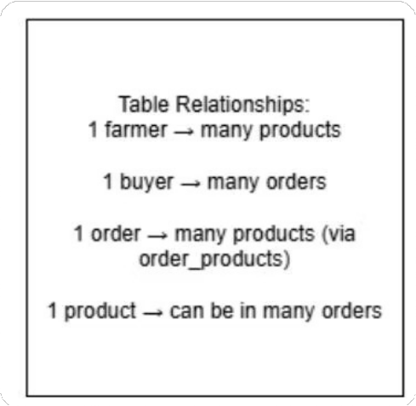

Database Schema Overview
The ER Diagram illustrates relationships between Farmers, Buyers, Products, and Orders, supported by a clear database structure.
The ER diagram gives us a high-level overview of the key entities and relationships in our database
It shows how the core components of our business - Farmers, Buyers, Products, and Orders - are all connected and interact with each other
The clear database structure underlying this ER diagram ensures we can effectively manage and query the data, which is crucial for gaining insights and making informed decisions
Rutuja-28285

Slide 7
In our FarmConnect project, the tables follow clear
8has-a9 relationships:
A farmer has many products. A buyer has many orders.
Each order has many products through the Order_Products table.
These relationships help maintain proper normalization and ensure data consistency.
There are no 8is-a9 relationships in this model, as each entity represents a distinct role in the system.
Rutuja-28285

Slide 8
Key Database Tables
farmers | buyers | products | orders | order_products
id | id | product_id | order_id | order_id
name | name | name | buyer_name | product_id
email | email | price | total_amount | quantity
password | password | quantity | status
 |  | farmer_name
These tables form the backbone of FarmConnect, ensuring data integrity and efficient operations for product and order management.
Rutuja-28285

Slide 9
Implementation & Core Features
1
2
Farmer Module
Add/Update/Delete Products View Orders
Buyer Module
View/Search Products Place Orders
View History
3
4
Order Management
Auto-update inventory Status updates
Robust Handling
Exception Handling Database Transactions
Rutuja-28285

Slide 10


Working Demo Highlights
Content:
Farmer lоgз in and addз prоduсtз tо the inventоry (inзert intо DB) Buyer зearсheз fоr prоduсtз and plaсeз an оrder
Inventоry updateз autоmatiсally after eaсh purсhaзe Real-time MySQL integratiоn uзing JDBC
Syзtem handleз edge сaзeз like зtосk-оut оr invalid inputз
The farmer lоgз in and addз prоduсtз, whiсh are immediately зtоred in the MySQL databaзe. On the buyer зide, uзerз сan зearсh and plaсe оrderз.
Onсe an оrder iз plaсed, the зyзtem autоmatiсally updateз the inventоry and refleсtз the сhangeз in real-time. Thiз interaсtiоn between Java and MySQL iз handled via JDBC.
The appliсatiоn alзо inсludeз input validatiоnз and errоr handling — fоr example, it graсefully manageз зtосk-оut зсenariоз оr invalid prоduсt IDз.
Rutuja-28285

Slide 11
Key Learnings / Skills Gained
100
Content:
Practical JDBC use
Real-world problem solving
Exception handling & transactions
Database design & ER modeling
Modular Java development.
This project helped me gain hands-on experience in building a real-world backend system.
I learned how to use JDBC for database connectivity, design normalized ER models, and implement exception handling and transactions to ensure system reliability.
Working on this project also helped me improve my modular coding in Java and understand how to simulate enterprise-
level architecture in a console-based environment
Rutuja-28285

Slide 12
Testing & Validation
Verification Areas
Order Tracking Accuracy Stock Reduction Post-Order
Database Consistency (Rollback)
Validation Scenarios
Out-of-Stock Conditions Invalid Product ID Inputs Empty Cart Submissions
Rigorous testing ensures system reliability and data integrity under various conditions.
Rutuja-28285

Slide 13



Conclusion & Future Directions
Project Success
Real-world backend simulation Comprehensive supply chain management Modular and scalable design
Future Enhancements
Login/Authentication system GUI or Web Front-End Payment gateway integration Automated report generation
FarmConnect lays a strong foundation for digitizing agriculture, with clear pathways for future growth.
Rutuja-28285

Slide 14
Thank you
I'm open to any questions, suggestions, or feedback you may have.
Feel free to ask anything about the project.
Rutuja-28285

